Slide 1
Multiprocessor Coordination
CS422/522 Lecture 16
12 November 2014
Last updated: 12 November 2014

Slide 2
Outline
Recap: Locks in xv6
Test-and-test-and-set
Ticket Locks
Array Locks
MCS Lock
Lock-free Data Structures
Read-copy Update
Wrap-Up

Slide 3
Recap: Locks in xv6 (and JOS)
acquire(struct spinlock *lk)
{
while(xchg(&lk−>locked, 1) != 0);
}
release(struct spinlock *lk)
{
xchg(&lk−>locked, 0);
}
Question: Why XCHG in release()?

Slide 4
XCHG as a test-and-set
test_and_set(addr)
{
int initial = *addr;
*addr = 1;
return initial;
}
But it needs to do this atomically...

Slide 5
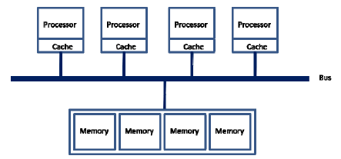
Bus-based shared memory
each addr in cache as either shared (S) or exclusive (X)
invariant: addr X in exactly one cache OR X in no caches and has same value in all S caches and in memory

Slide 6
Bus-based shared memory
Reads:
  CPU can read from its own cache if S or X
  Otherwise, set cache to S, any cached X to S, fetch from X cache or memory (uses bus)
Writes:
  CPU can write to its own cache if X
  Otherwise, set cache to X, invalidate other caches (uses bus)

Slide 7
Why does this matter?
acquire(struct spinlock *lk)
{
while(xchg(&lk−>locked, 1) != 0);
}
Since XCHG writes atomically, addr must be X in cache
If multiple CPUs doing XCHG, bus constantly busy
Hurts performance even on CPU with lock
xv6 spinlock does not perform well under contention

Slide 8
Outline
Recap: Locks in xv6
Test-and-test-and-set
Ticket Locks
Array Locks
MCS Lock
Lock-free Data Structures
Read-copy Update
Wrap-Up

Slide 9
Test-and-test-and-set
acquire(struct spinlock *lk)
{
while((lk->locked != 0) || (xchg(&lk−>locked, 1) != 0));
}
First test is ordinary load instruction (S in cache OK)
Only if succeeds move on to expensive XCHG
  Example: 8 CPUs all want lock
  1 gets lock, 7 others call XCHG once
  spin on LOAD, S in caches so no bus
  release lock; 1 gets lock, 6 call XCHG once
  8 + 7 + ... = O(n^2) bus lockings

Slide 10
Outline
Recap: Locks in xv6
Test-and-test-and-set
Ticket Locks
Array Locks
MCS Lock
Lock-free Data Structures
Read-copy Update
Wrap-Up

Slide 11
Ticket Locks
struct lock {
int next = 0;
int serving = 0;
}
acquire(struct lock *lk)
{
  int mine = fetch_and_increment(&lk->next);
  while(mine != lk->serving);
}
release(struct lock *lk)
{
lk->serving += 1;
}

Slide 12
Ticket Locks
Single atomic instruction (no spinning)
Still O(n^2) bus transactions. Why?
release() invalidates lk->serving in all caches
Same pattern as test-and-test-and-set
Problem: all CPUs spin on the same location

Slide 13
Outline
Recap: Locks in xv6
Test-and-test-and-set
Ticket Locks
Array Locks
MCS Lock
Lock-free Data Structures
Read-copy Update
Wrap-Up

Slide 14
Array Locks
struct lock {
  int next = 0;
  int slots[LEN] = {1}; // 1 = has_lock, 0 = must_wait
}
acquire(struct lock *lk)
{
  int mine = fetch_and_increment(&lock->next);
  while(slots[mine % LEN] == 0);
  slots[mine % LEN] = 0; // reset for next time
}
release(struct lock *lk)
{
slots[(mine + 1) % LEN] = 1;
}

Slide 15
Array Locks
Down to O(n) in bus transactions! Why?
release() invalidates only a single cache
Caveat: assumes slots aligned with cache lines
But O(n) in space per lock

Slide 16
Outline
Recap: Locks in xv6
Test-and-test-and-set
Ticket Locks
Array Locks
MCS Lock
Lock-free Data Structures
Read-copy Update
Wrap-Up

Slide 17
MCS Lock
acquire(lock *lk, qnode *I) {
I->next = NULL;
    qnode *predecessor = fetch_and_store(lk, I)
    if(predecessor != NULL) // queue was non-empty
  I->locked = 1;
  predecessor->next = I;
  while(I->locked == 1); // spin
}
release(lock *lk, qnode *I) {
if(I->next == NULL) // no known successor
if(compare_and_swap(lk, I, NULL)
return;
while(I->next == NULL); // spin
I->next->locked = 0;
}

Slide 18
MCS Lock
Preserves O(n) bus transactions from array lock
O(1) space overhead - each process with one qnode, uses for any lock it's waiting on

Slide 19
Outline
Recap: Locks in xv6
Test-and-test-and-set
Ticket Locks
Array Locks
MCS Lock
Lock-free Data Structures
Read-copy Update
Wrap-Up

Slide 20
Lock-free Data Structures
Consider a typical stack
void push(elem *e) {
e->next = top;
top = e;
}
elem *pop() {
elem *e = top;
top = e->next;
return e;
}
Clearly not concurrency-safe!
Can we make it safe without locks?

Slide 21
Compare-and-swap
bool cmpxchg(int *addr, int old, int new)
{
  int was = *addr;
  if(was == old)
  *addr = new;
  return was;
}

Slide 22
A Lock-free Stack
void push(elem *e) {
  while(true) {
    e->next = top;
    if(cmpxchg(&top, e->next, e) == e->next)
    break;
  }
}
elem *pop() {
  while(true) {
    elem *e = top;
    if(cmpxchg(&top, e, e->next) == e)
    break;
  }
  return e;
}

Slide 23
Why lock-free (or not)?
Pros
  Preemption not an issue - just update and retry
  Readers don't need any extra synchronization
Cons
  Writing lock-free data structures is complicated

Slide 24
Outline
Recap: Locks in xv6
Test-and-test-and-set
Ticket Locks
Array Locks
MCS Lock
Lock-free Data Structures
Read-copy Update
Wrap-Up

Slide 25
Read-Copy Update
Extends the swapping idea of lock-free
Two goals:
  Make updates appear atomic to readers
  Use any other scheme (locks, lock-free, etc.) to coordinate between updaters
Key idea: leave old data for readers, don't update in place
  Update by copying data, atomically swapping pointers

Slide 26
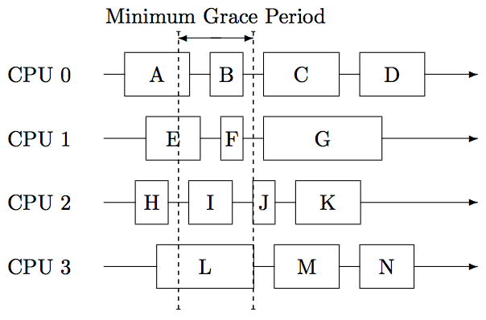
Asynchronous Free
When is it safe to free the old data?
Simple answer: After everyone is done using it.

Slide 27
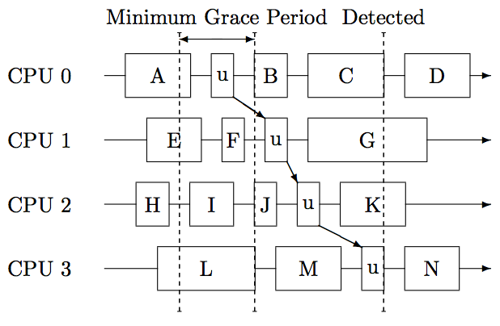
Detecting "Quiescent" States
One approach: CPU hopping

Slide 28
RCU in Practice
Kernel module unloading
  Anyone already using module can continue
  Any new attempt to use will fail
See paper for more details

Slide 29
Outline
Recap: Locks in xv6
Test-and-test-and-set
Ticket Locks
Array Locks
MCS Lock
Lock-free Data Structures
Read-copy Update
Wrap-Up

Slide 30
Lab 5 Grades
Code: 72/75
  Questions: 3/3

Slide 31
Lab 6
Lab 6 must be completed by tomorrow (Thursday).

Slide 32
Lab 7
Due December 4th. No late days.
E-mail us what you will be doing and (if applicable) who you are working with.
Default project (E1000 interrupts instead of polling) is not sufficient for group project - need to do more.

Slide 33
Next Time
Monday 1:00PM
Distributed Systems

